Slide 1
Introduction to Computer Graphics with WebGL
Ed Angel
Professor Emeritus of Computer Science
Founding Director, Arts, Research, Technology and Science Laboratory
University of New Mexico
Angel and Shreiner: Interactive Computer Graphics 7E © Addison-Wesley 2015

Slide 2
Programming with WebGL
Part 1: Background
Ed Angel
Professor Emeritus of Computer Science
University of New Mexico
Angel and Shreiner: Interactive Computer Graphics 7E © Addison-Wesley 2015

Slide 3
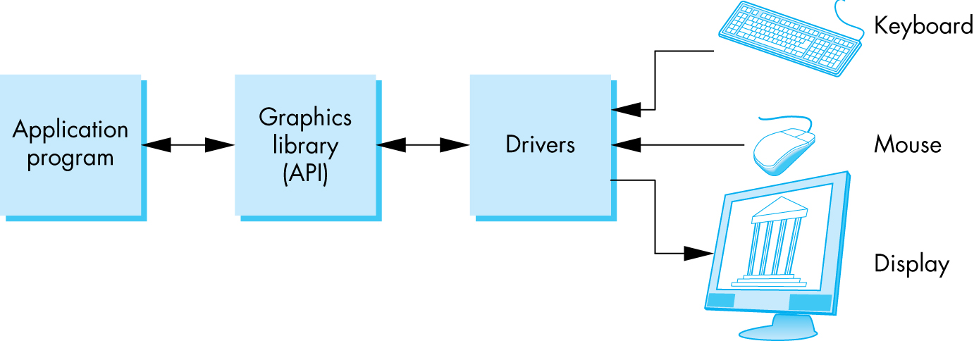
OpenGL Architecture
Angel and Shreiner: Interactive Computer Graphics 7E © Addison-Wesley 2015

Slide 4
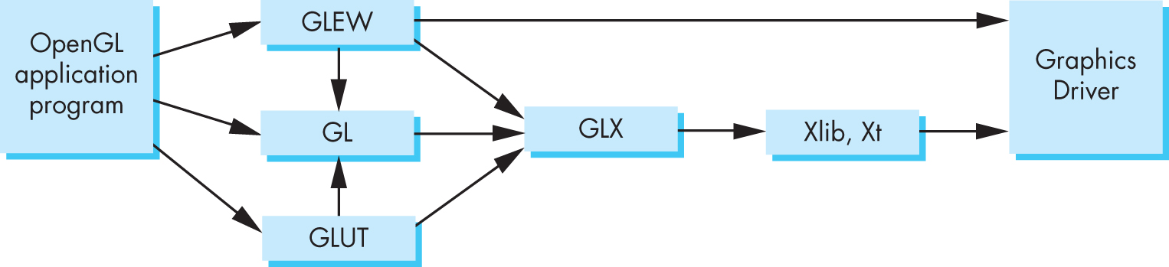
Software Organization
Angel and Shreiner: Interactive Computer Graphics 7E © Addison-Wesley 2015

Slide 5
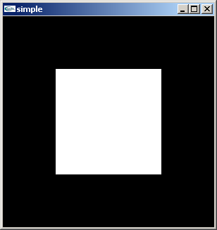
A OpenGL Simple Program
Generate a square on a solid background
Angel and Shreiner: Interactive Computer Graphics 7E © Addison-Wesley 2015

Slide 6

It used to be easy
#include <GL/glut.h>
void mydisplay(){
glClear(GL_COLOR_BUFFER_BIT);
glBegin(GL_QUAD;
glVertex2f(-0.5, -0.5);
glVertex2f(-0,5, 0,5);
glVertex2f(0.5, 0.5);
glVertex2f(0.5, -0.5);
glEnd()
}
int main(int argc, char** argv){
glutCreateWindow("simple");
glutDisplayFunc(mydisplay);
glutMainLoop();
}
Angel and Shreiner: Interactive Computer Graphics 7E © Addison-Wesley 2015

Slide 7
What happened?
Most OpenGL functions deprecated
  immediate vs retained mode
  make use of GPU
Makes heavy use of state variable default values that no longer exist
  Viewing
  Colors
  Window parameters
However, processing loop is the same
Angel and Shreiner: Interactive Computer Graphics 7E © Addison-Wesley 2015

Slide 8
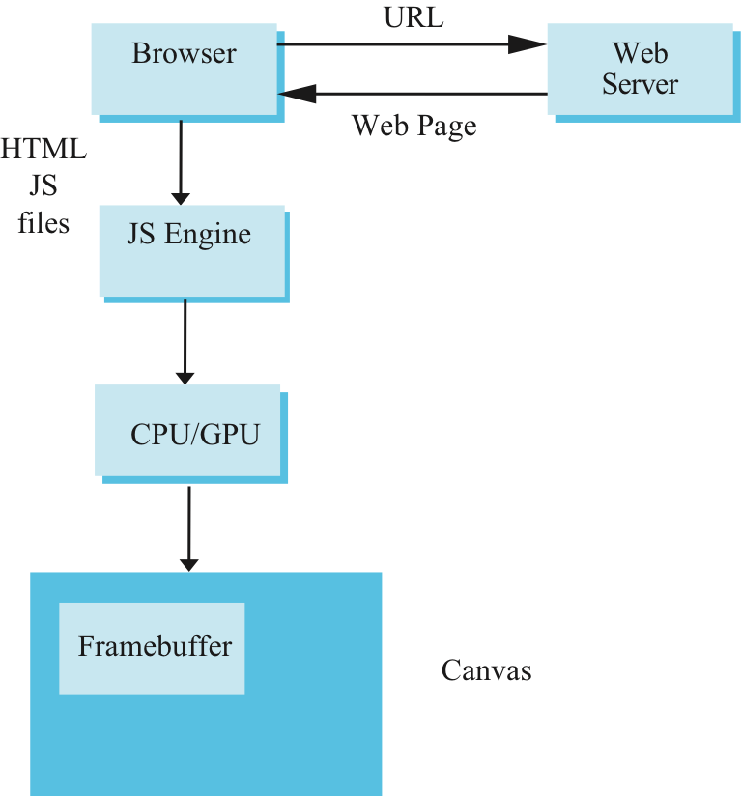
Execution in Browser
Angel and Shreiner: Interactive Computer Graphics 7E © Addison-Wesley 2015

Slide 9
Event Loop
Remember that the sample program specifies a render function which is a event listener or callback function
  Every program should have a render callback
  For a static application we need only execute the render function once
  In a dynamic application, the render function can call itself recursively but each redrawing of the display must be triggered by an event
Angel and Shreiner: Interactive Computer Graphics 7E © Addison-Wesley 2015

Slide 10
Lack of Object Orientation
All versions of OpenGL are not object oriented so that there are multiple functions for a given logical function
Example: sending values to shaders
  gl.uniform3f
  gl.uniform2i
  gl.uniform3dv
Underlying storage mode is the same
Angel and Shreiner: Interactive Computer Graphics 7E © Addison-Wesley 2015

Slide 11
WebGL function format
function name
dimension
gl.uniform3f(x,y,z)
x,y,z are variables
belongs to WebGL canvas
gl.uniform3fv(p)
p is an array
Angel and Shreiner: Interactive Computer Graphics 7E © Addison-Wesley 2015

Slide 12
WebGL constants
Most constants are defined in the canvas object
  In desktop OpenGL, they were in #include files such as gl.h
Examples
  desktop OpenGL
    glEnable(GL_DEPTH_TEST);
  WebGL
    gl.enable(gl.DEPTH_TEST)
  gl.clear(gl.COLOR_BUFFER_BIT)
Angel and Shreiner: Interactive Computer Graphics 7E © Addison-Wesley 2015

Slide 13
WebGL and GLSL
WebGL requires shaders and is based less on a state machine model than a data flow model
Most state variables, attributes and related pre 3.1 OpenGL functions have been deprecated
Action happens in shaders
Job of application is to get data to GPU
Angel and Shreiner: Interactive Computer Graphics 7E © Addison-Wesley 2015

Slide 14
GLSL
OpenGL Shading Language
C-like with
  Matrix and vector types (2, 3, 4 dimensional)
  Overloaded operators
  C++ like constructors
Similar to Nvidia’s Cg and Microsoft HLSL
Code sent to shaders as source code
WebGL functions compile, link and get information to shaders
Angel and Shreiner: Interactive Computer Graphics 7E © Addison-Wesley 2015

